Slide 1
Unit-3
Computer Storage

Slide 2
Computer Memory
Computer memory is a storage device/place that is used to store information.
OR
Memory in computing refers to the hardware resources that store data and instructions, either temporarily or permanently, enabling computers to function effectively.

Slide 3
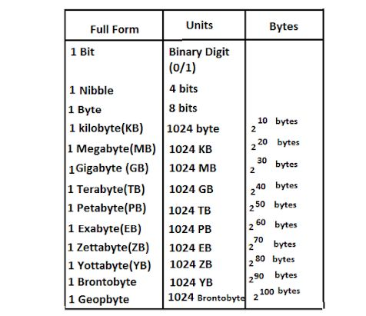
Computer Memory Unit

Slide 4
Types of Memory:
1.Primary Memory
2.Secondary Memory
1.Primary Memory:-
It is also known as main memory, the memory unit that communicate directly with the CPU called primary memory.
Stores data and instructions currently in use by the processor.
Fast and volatile (data is lost when power is off).
Examples: RAM (Random Access Memory), Cache.

Slide 5
2.Secondary Memory
It is also known as auxiliary memory ,the memory unit which is provide backup storage called secondary memory
Stores data and programs permanently for future use.
Non-volatile (retains data without power).
Examples: Hard drives, SSDs,Pendrive

Slide 6
Difference between primary and secondary memory
Primary | Secondary
Primary memory is also called main memory. | Secondary memory is also called auxiliary memory.
It is temporary memory of a computer | It is Permanent memory of a computer
It has fast access time. | It has slow access time.
It is Smaller in size. | It is biggest in size
It is directly communicate to CPU. | It is not directly communicate to CPU,it requires primary memory for its operation
It is more expensive | It is cheaper than primary
Volatile in nature except ROM. Ex-RAM,cache,ETC. | Non-Volatile in nature EX-HDD,DVD

Slide 7
RAM(Random Access Memory)
RAM stands for “Random access meomry”.It is a volatile memory also known as direct access memory. The tasks currently performed by the CPU are stored in RAM.
RAM is a part of CPU.
RAM data directly accessed by the CPU.
It is a very fast memory .
TYPES of RAM-
i.SRAM
ii.DRAM

Slide 8
i.SRAM
SRAM stands for Static Random Access Memory. Data remains in static RAM as long as there is power supply.
It doesn’t need to be refreshed again and again.
It is also used as cache memory.
more expensive

Slide 9
ii. DRAM
DRAM stands for Dynamic Random Access Memory. Data can be stored in the DRAM only when it is refreshed frequently.
Slower,
less expensive,
used for main memory.

Slide 10
ROM (READ ONLY MEMORY)
ROM stands for “ Read Only Memory”. In this memory we can only read but can’t write on it. ROM data is permanently during creation of information that’s why it is called non-volatile memory.
used to store firmware or software that does not change frequently.

Slide 11
Types
PROM(Programmable Read Only Memory)
A type of ROM that can be programmed once by the user after manufacturing.
Features:
Blank at the time of purchase.
Uses a special device called a PROM programmer to write data.
Once programmed, the data cannot be erased or altered.
Often used in applications where data needs to be permanently written, such as in firmware for simple devices.

Slide 12
EPROM(Erasable Read Only Memory)
A type of ROM that can be erased and reprogrammed multiple times using ultraviolet (UV) light.
Features:
Contains a transparent quartz window through which UV light can pass.
To erase data, the chip is exposed to UV light for a specific period (usually about 20-30 minutes).
After erasure, it can be reprogrammed using a special device called an EPROM programmer.

Slide 13
3. EEPROM (Electrically Erasable Programmable Read Only Memory)
A type of ROM that can be erased and reprogrammed electrically, offering greater flexibility.
Features:
Data can be erased and rewritten at the byte level, unlike EPROM, which requires full erasure.
Does not require exposure to UV light; reprogramming can be done in-system using a standard electrical signal.
Supports thousands of write/erase cycles.

Slide 14
Secondary Memory
Store personal data
Store huge data
Access anytime

Slide 15
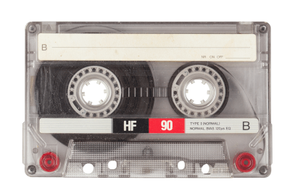
Types of Secondary Storage Devices
1.Magnetic Tape
Developed in Germany in 1928
It use a read-write mechanism.
Data read and write speed is slower.
It becomes more scarce due to the advanced storage devices.

Slide 16
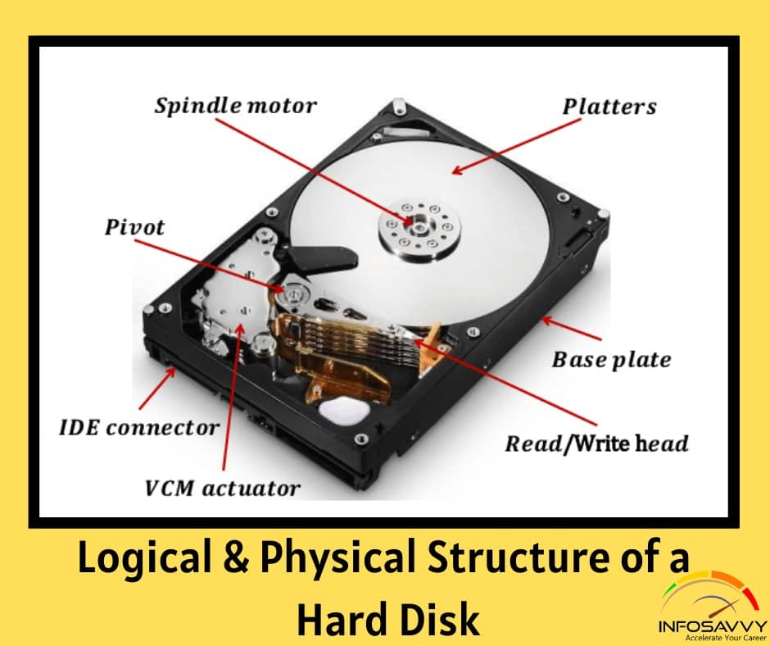
Magnetic Disk
A flat disc covered with a
magnetic coating to write ,
rewrite and access data.
Two types of magnetics disks
are hard disks and floppy disks

Slide 17
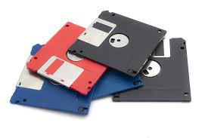

Slide 18
Hard Disk
It is also called a hard drive.
It stores the operating system,applications,documents,files,pictures and music.
They are less expensive and they can store terabytes of information.
It comes in both variants ,internal as well as external.

Slide 19
Floppy disc
A floppy disk is a square plastic case.
These disks are available in sizes like 8 inches, 5.25 inches, and 3.5 inches .
Due to the other portable storage devices ,they are less in use nowadays.
The floppy disk frive is used to read and write data in floppy disks.

Slide 20
Optical disk
It is an electronic storage medium because it uses low-power laser beams to record and read data.
The data is read while bouncing the laser beam on the surface of the disk.
CD, DVD, Blu-ray all are called optical disks.

Slide 21
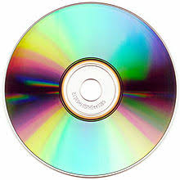
CD-Compact Disc
A Compact Disc (CD) is a circular shape device made of polycarbonate
Plastic .
CD has two types.one is CD-R(compact disc recordable-read but can’t write) and the second is CD-RW (compact disc rewritable-read and write).
It can store up to 700MB of data.

Slide 22
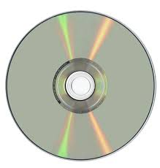
DVD-Digital Versatile Disc
The DVD is a digital video disc or digital versatile disc, data storage format invented and developed in 1995 and released in late 1996.Currently, a DVD can hold a maximum of 17.8GB of data.

Slide 23
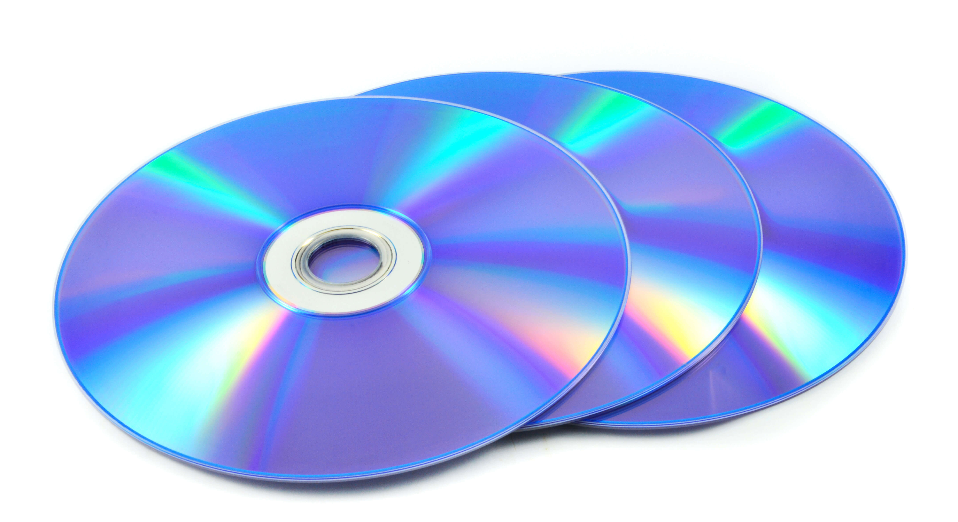
Blu-ray
It is like the third generation optical disc,after CDs and DVDs , and capable of storing several hours of high- definition video.
The maximum storage capacity of blu ray discs is up to 50GB.

